Slide 1
CREDIT Risk EDA CASE STUDY
By Jugal Deshmukh

Slide 2
Overview
This case study aims to give you an idea of applying EDA in a real business scenario.
You will also develop a basic understanding of risk analytics in banking and financial services.
We will also understand how data is used to minimise the risk of losing money while lending to customers.

Slide 3
Business objectives
This case study aims to identify patterns which indicate if a client has difficulty paying their installments which may be used for taking actions such as denying the loan, reducing the amount of loan, lending (to risky applicants) at a higher interest rate, etc. This will ensure that the consumers capable of repaying the loan are not rejected. Identification of such applicants using EDA is the aim of this case study.

Slide 4
DATA UNDERSTANDING
This dataset has 3 files as explained below:
'application_data.csv' contains all the information of the client at the time of application. The data is about whether a client has payment difficulties.
'previous_application.csv' contains information about the client’s previous loan data. It contains the data whether the previous application had been Approved, Cancelled, Refused or Unused offer.
'columns_description.csv' is a data dictionary which describes the meaning of the variables.

Slide 5
Categorical Univariate analysis for target 0

Slide 6
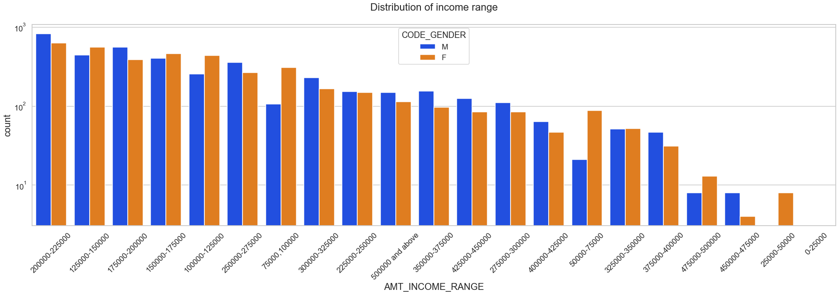
DISTRIBUTION of income range according to gender(TARGET 0)((e
Points to be concluded from the above graph.
Male and female count is almost equal in number.
Income range from 100000 to 225000 is having the most number of credits.
This graph show that both males and females are having almost equal number of credits.
Very less count for income range 450000 - 500000 and above.

Slide 7
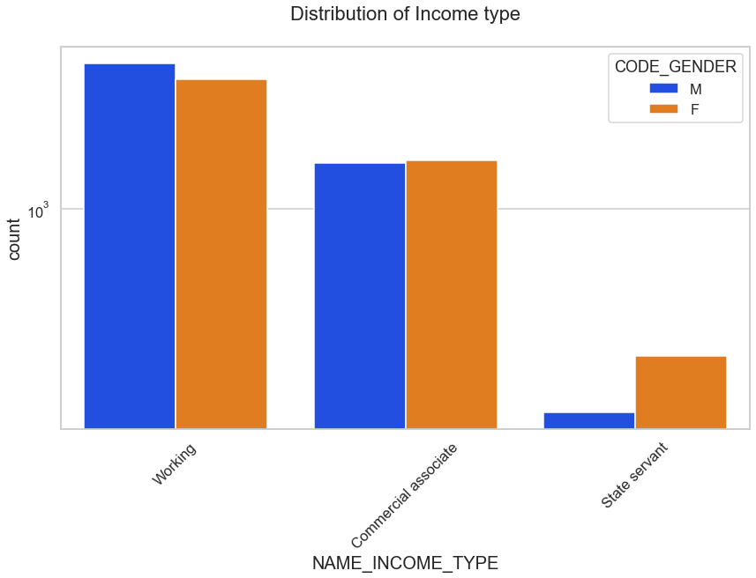
DISTRIBUTION of income TYPE according to gender (Target 0)geibution of income type
Points to be concluded from the above graph.
The higher number of credits is for income type 'Working'.
For income type ‘Working’, ’Commercial associate’, the number of credits are higher than ‘State Servant.
For this Females are having more number of credits than male.
Here the lowest number of credits is for the income type 'State Servant'

Slide 8
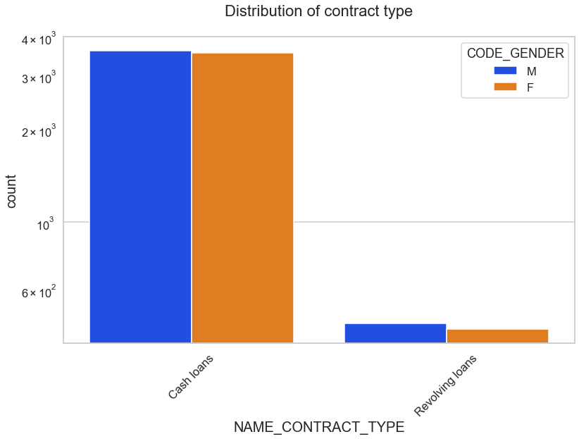
Distribution for contract type
Points to be concluded from the above graph.
For contract type ‘cash loans’ is having higher number of credits than ‘Revolving loans’ contract type.
Here the males and females both are having almost equal number of credits for their respective contract type.
.

Slide 9
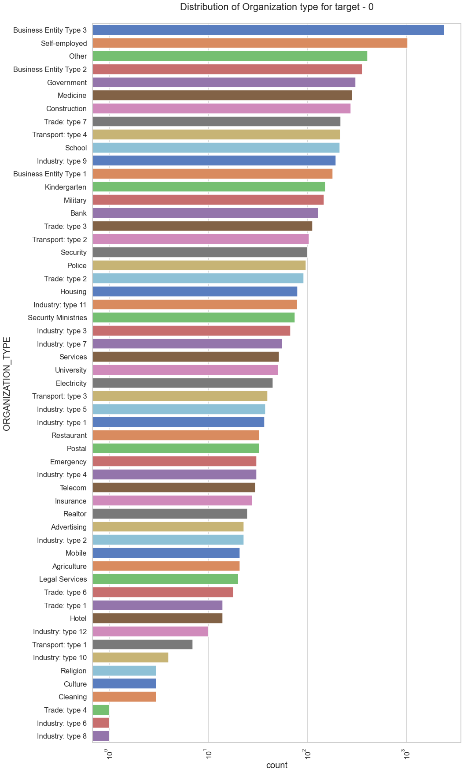
Distribution of organization type
Points to be concluded from the above graph.
Clients which have applied for credits are from most of the organization type 'Business entity Type 3’ , ‘Self employed’, ‘Other’ , Business entity Type 2’,‘Medicine’ and ‘Government’.
Less clients are from Industry Culture, Religion, Industry type 6, Trade type 4 and Industry type 8

Slide 10
Categorical Univariate analysis for target 1

Slide 11
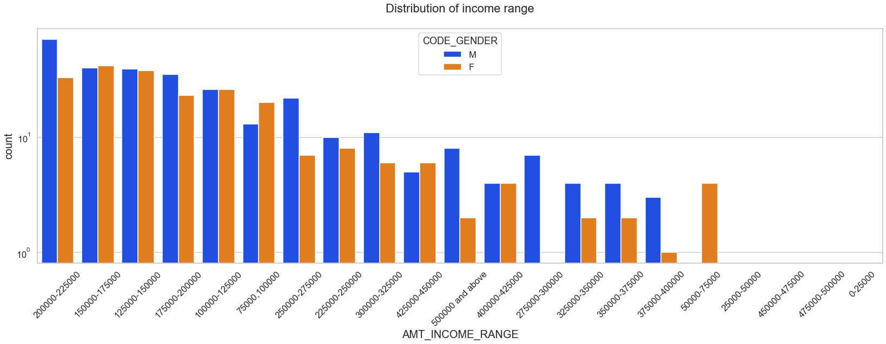
Distribution of Income range
Points to be concluded from the graph on the right side.
Male counts are higher than female.
Income range from 100000 to 200000 is having more number of credits.
This graph show that males are more than female in having credits for that range.
Very less count for income range 300000-400000 and above.

Slide 12
Distribution of income type
Points to be concluded from the graph on the right side.
For income type ‘working’, ’commercial associate’, the number of credits are higher than ‘State Servant’
For this Females are having more number of credits than Males.
Less number of credits for income type ‘State Servant’.

Slide 13
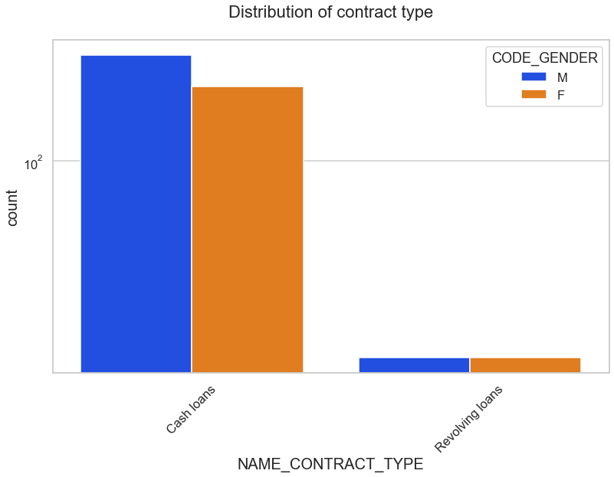
Distribution for contract type
Points to be concluded from the graph on the right.
For contract type ‘cash loans’ is having higher number of credits than ‘Revolving loans’ contract type.
For this males code_gender is leading for applying credits.
For Revolving loans there are equal number of males and females

Slide 14
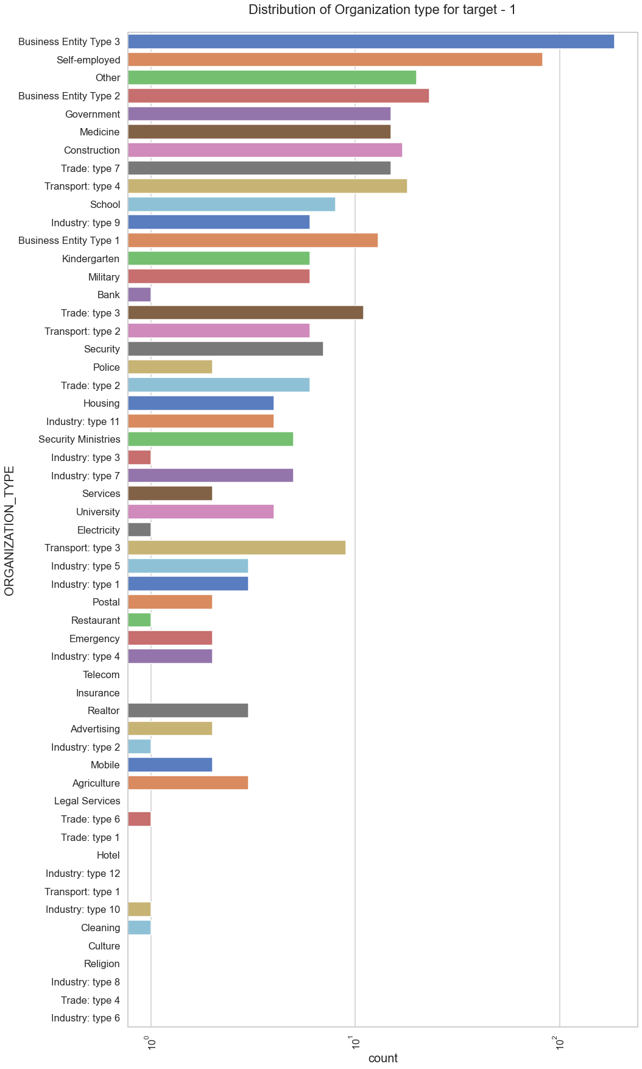
Distribution of organization type
Points to be concluded from the graph on the right.
Clients which have applied for credits are from most of the organization type ‘Business entity Type 3’ , ‘Self employed’ , ‘Other’ , ‘Medicine’, ‘Construction’ and ‘Government’.
Less clients are from Industry Telecom, Insurance, Mobile, Agriculture, Restaurant etc
Same as type 0 in distribution of organization type.

Slide 15
Bivariate analysis for type 0

Slide 16
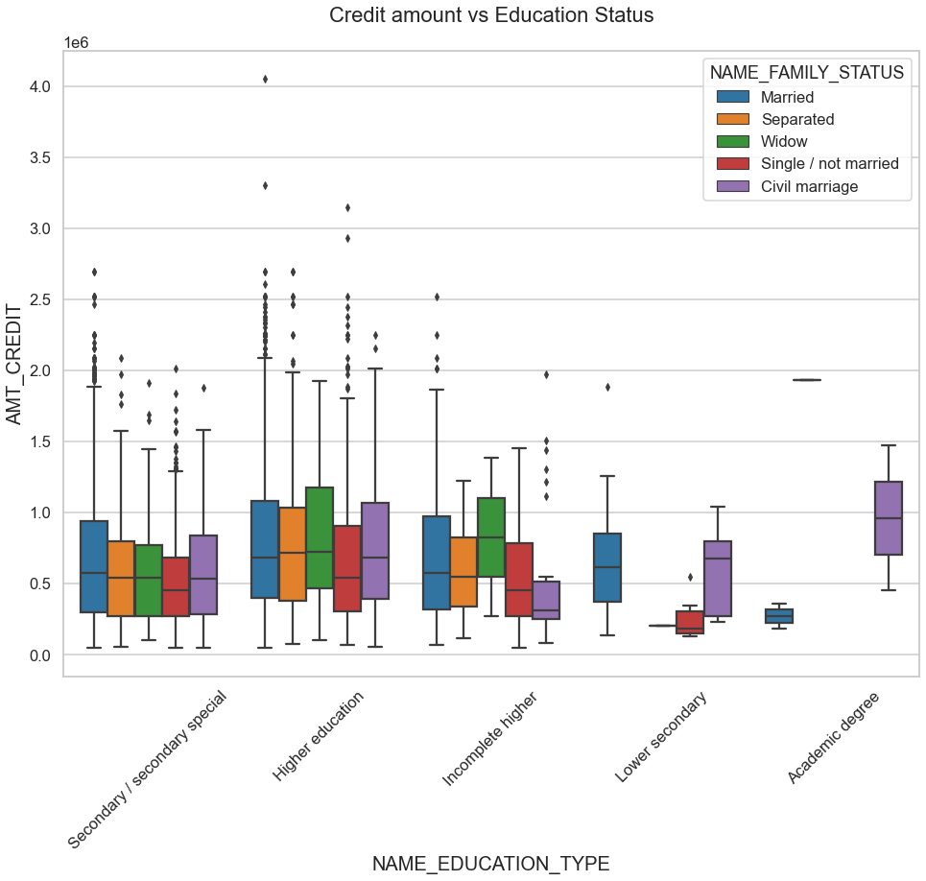
Credit amount vs Education Status
Few points can be concluded from the graph.
Family status of ‘Civil marriage', ‘Married' and ‘Single' of Academic degree education are having higher number of credits than others.
Higher education of family status of 'marriage', 'single' and 'civil marriage' are having more outliers.
Civil marriage for Academic degree is having most of the credits in the third quartile.

Slide 17
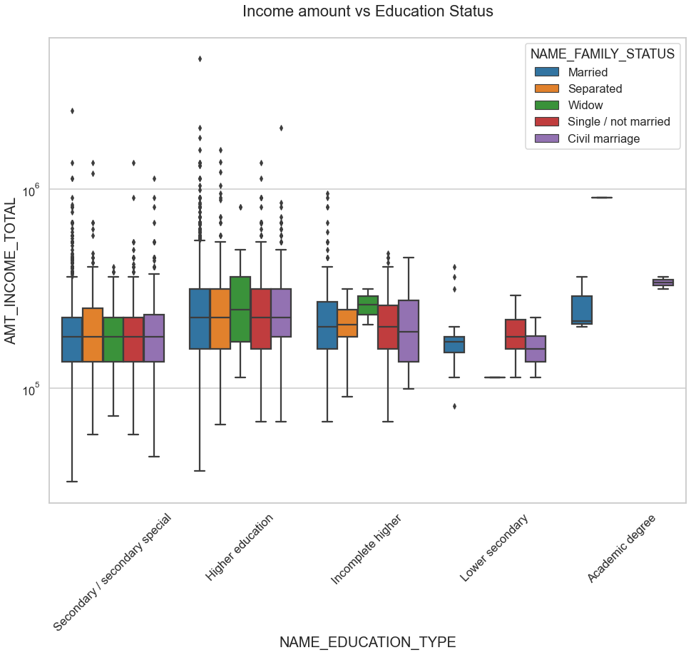
Income amount vs Education Status
Few points can be concluded from the graph.
For Education type 'Higher education' the income amount mean is mostly equal with family status. It does contain many outliers.
Less outlier are having for Academic degree but the amount of data is very less.
Lower secondary of civil marriage family status are have less income amount than others.

Slide 18
Bivariate analysis for type 1

Slide 19
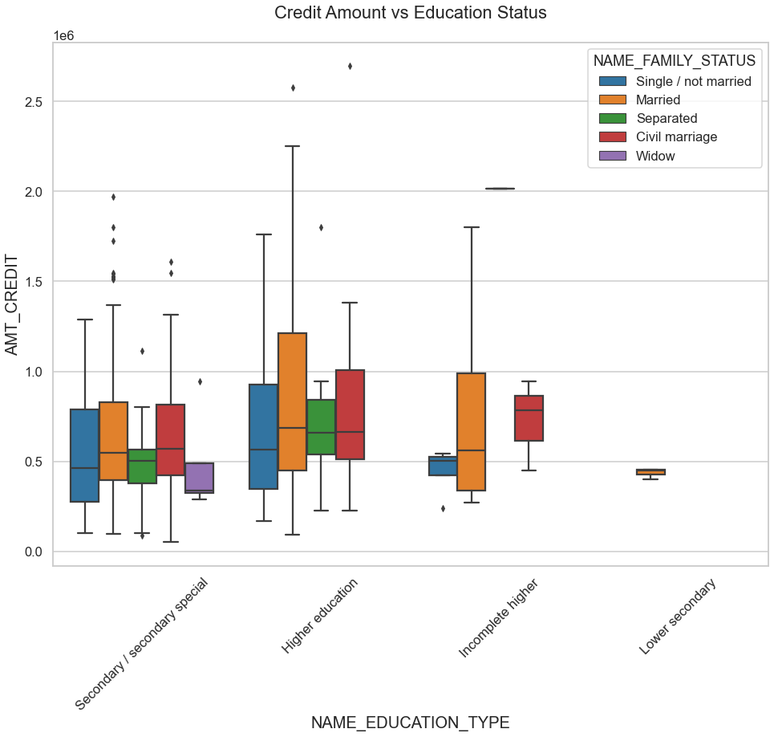
Credit amount vs Education Status
Few points can be concluded from the graph.
Quite similar from Target 0, we can say that Family status of ‘Civil marriage', ‘Married' and ‘Single' of Academic degree education are having higher number of credits than others.
Most of the outliers are from Education type 'Higher education' and 'Secondary’.
Civil marriage for Academic degree is having most of the credits in the third quartile.

Slide 20
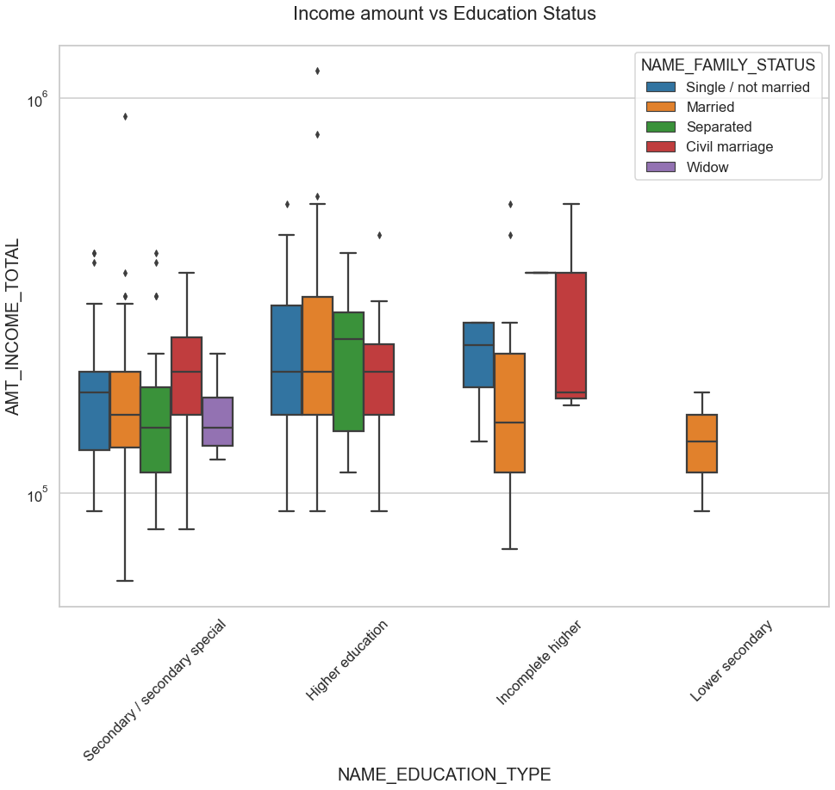
Income amount vs Education Status
Few points can be concluded from the graph.
Have some similarity with Target0, From above boxplot for Education type 'Higher education' the income amount is mostly equal with family status.
Family status of Civil marriage in incomplete higher education type is having highest number of individual credits
No outlier are having for Lower Secondary but there income amount is the lowest.

Slide 21
Univariate analysis after merging previous data

Slide 22
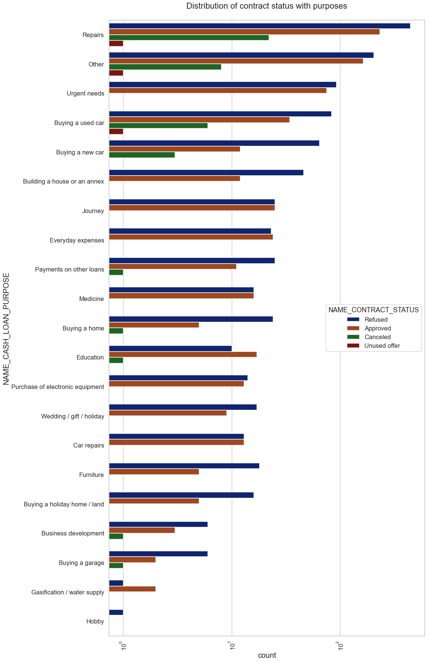
Distribution of contract status with purposes
Points to be concluded from above plot:
Most rejection of loans came from purpose 'repairs'.
For journey purposes we have equal number of approves and rejection
buying a new car, buying a home, buying a garage and furniture is having significant higher rejection than approves.
Repairs has the most number of cancelled contracts
Only Repairs, Others and buying a used car have unused offer contracts

Slide 23
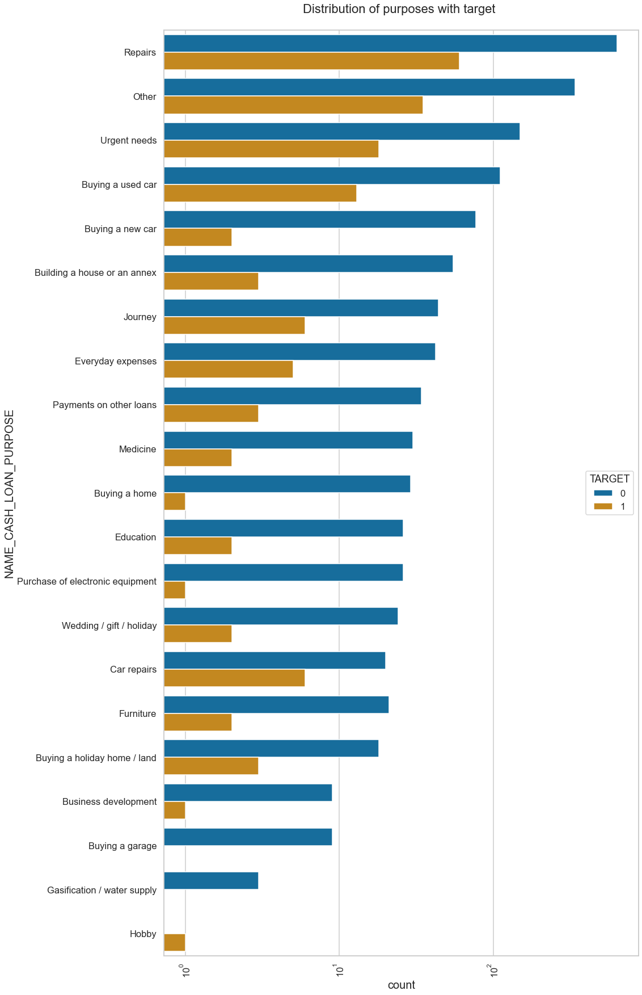
Distribution of purposes with target
Few points we can conclude from above plot:
Loan purposes with 'Repairs' are facing more difficulites in payment on time.
There are few places where loan payment is significant higher than facing difficulties. They are 'Buying a garage’, 'Business development', 'Buying land’, 'Buying a new car' and 'Education' Hence we can focus on these purposes for which the client is having for minimal payment difficulties.

Slide 24
Performing bivariate analysis on merged dataset

Slide 25
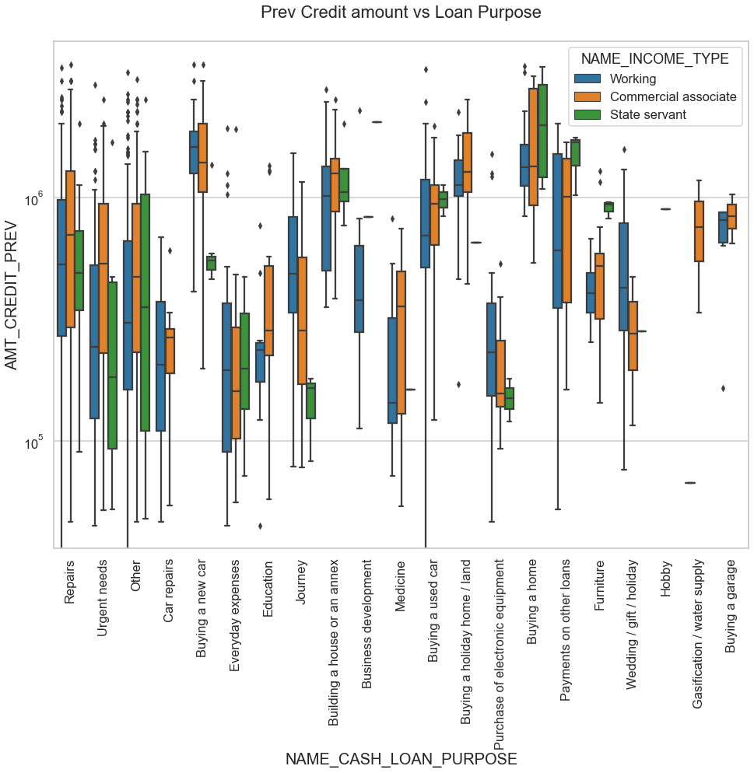

Slide 26
Prev Credit amount vs Loan Purpose
From the previous graph we can conclude some points-
The credit amount of Loan purposes like 'Buying a home','Buying a land','Buying a new car' and 'Building a house' is higher.
Income type of working have a significant amount of credit applied. Next to working category is the commercial associate income type.
Income type of Hobby is having the lowest credits applied for.

Slide 27
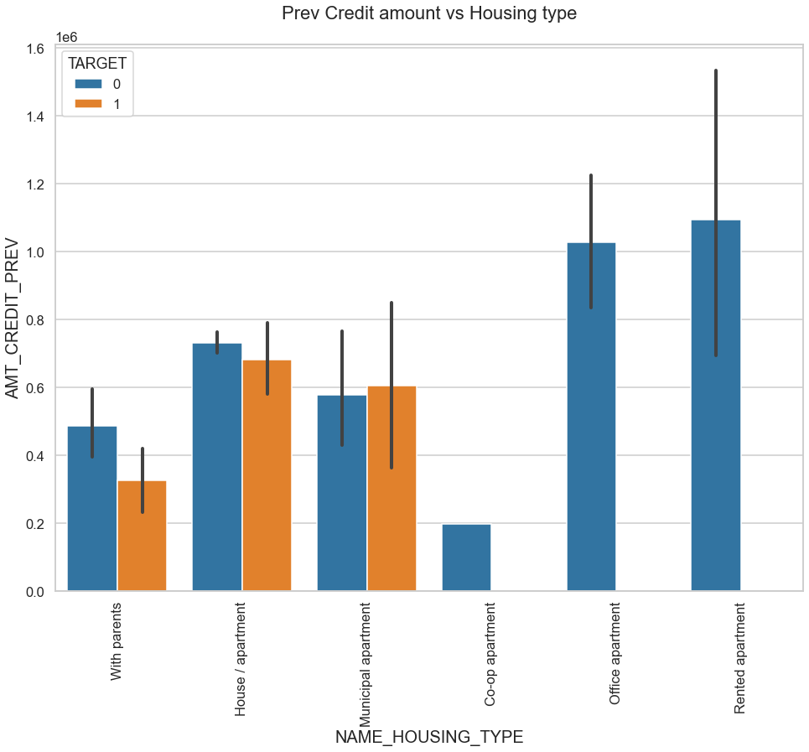
Prev Credit amount vs Housing type
Points to note from the bar plot :
Here for Rented apartment and Office apartment is having higher credit of target 0. These housing types are less likely to default.
House\apartment and Municipal apartment is having higher credit of target 1.These housing types are more likely to default.
So, we can conclude that bank should avoid giving loans to the housing type of House\apartment and Municipal apartment as they are having difficulties in payment. Bank can focus mostly on housing type with parents, Rented apartment and Office apartment for successful payments.

Slide 28
conclusion
Banks should focus more on contract type ‘Businessman’, 'Student', 'Government','Medicine' with housing ‘type for successful payments.
Banks should focus less on income type ‘Working’ as they are having most number of unsuccessful payments.
The loan purpose 'Repairs', ‘Urgent needs’ and 'Other' is having higher number of unsuccessful payments on time.
Get as much as clients from housing type ‘Office apartment’ and 'Rented apartment' as they are having least number of unsuccessful payments.

Slide 29
Thank you

